Slide 1
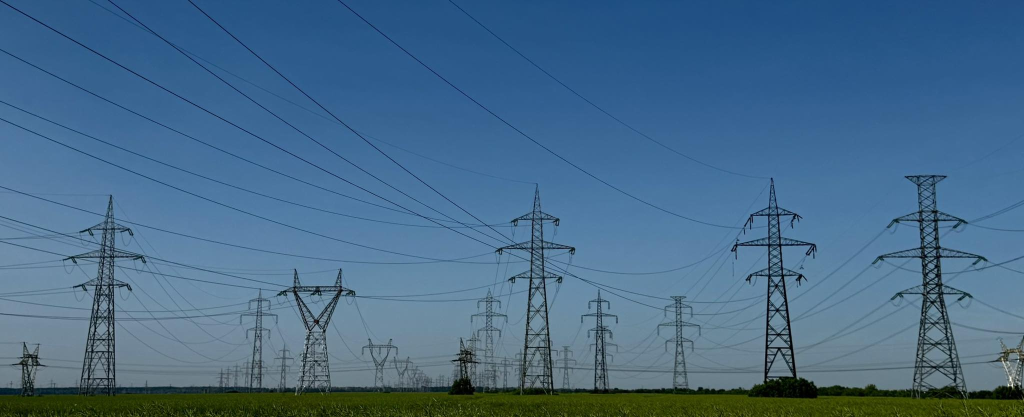


GENERAL PRESENTATION
Transelectrica SA
Transmission and System Operator of the Romanian Electrical Power System
We lead the power

Slide 2
General Presentation
Transelectrica
Operational Activity
Europe / CEE / Romania
Utilities / Electricity Transmission Network
Regulated Monopoly
General profile
Regulated prices
National monopoly of electricity transmission service
Defensive business model
Stable and predictable cash flow
Licenses, Assets, Certifications
25 years License for operation of SEN
49 ani Concession agreement from the Government of Romania (grid assets)
Certification of independence within the power sector: Ownership unbundling model
Regulatoru profile
Transparency and visibility (5-year tariff regulation periods with annual reviews)
Clear configuration for OPEX & CAPEX (regulated tariff)
ROI* regulated (built into network tariffs)
Free
Float
Romanian
State
* Return of investments

Slide 3
Romania at the crossroads...
European Context
…with UE and non-UE countries:
(EU legislation is not mandatory for all countries in the region)
i
…with different European congestion management regions:
Central Europe
South-East
Eastern Europe
ii

Slide 4


Operational Activity
General Presentation
What we do
Transport bulky volumes of electricity across Romania
Operate Romania’s cross-border power links with neighboring countries
What we don’t
Produce electricity
Trade in electricity
Deliver electricity supplies all the way to retail end-users
regulated
monopoly
Generation
(Plants)
End-users
Transmission
(HV grid)
Distribution
(LV grids)

Slide 5
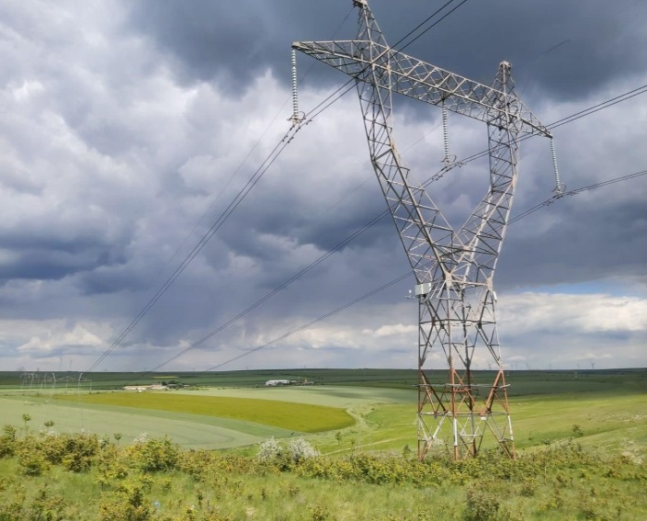


Key figures
General Presentation
 | 465 mill. lei EBITDA 9M 2025 |  | 183 mill. lei Net profit 9M 2025
 | 4.486 mill. lei Market value September 30, 2025 |  | Baa3 Moody’s (stable outlook)
mill lei

Slide 6





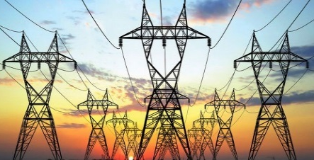
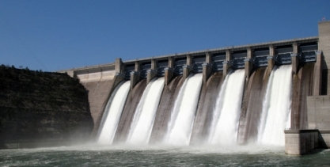
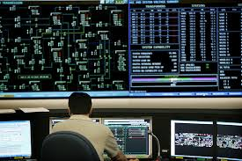
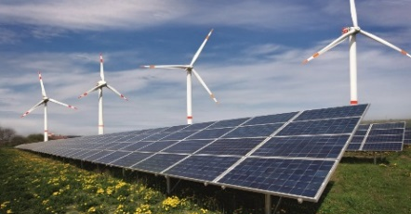
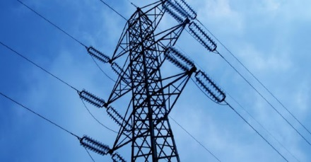
Core network operations
General Presentation
Transmission
Maintenance, operation and upgrade of the national high-voltage electric backbone
Operation of cross-border interconnection lines
High availability (low outage) rates
Unrestricted grid access for all users
Energy system operation
Real time monitoring and control of the entire national power system
Real-time grid balance assurance, harmonization between generation and consumption
Calculation of balancing reserves
Market balancing
Imbalance settlement process: measurement and financial settlement of network imbalances caused by temporary generation-consumption differences (TSO acts as a clearing agent for the entire market)

Slide 7




TSO unblunding certification
General Presentation
Transelectrica’s independence from the market side of the power sector (generation, sale/supply), given its position as transmission and system operator (TSO) of the Romanian power grid, was certified by the Romanian Energy Regulator according to the “Ownership Unbundling” model (EC endorsement on 12.10.2015) on 08.12.2015 (ANRE Order 164 - OJ 908). Certification was published in EU’s Official Journal on 08.01.2016
Regulated segments
(networks - natural monopolies)
Generation
Sale/Supply
Transmission
(TSO)
Distribution
Certified
Ownership Unbundling
Market segments - competition was introduced

Slide 8







General Presentation
Regulated income Methodology Tariff
Transport service customers
The tariff applied to the energy injected/extracted into/from the grid
(Lei/MWh)
Extraction from the network
Injection into the network
Transport
Consumers*
(industrial)
For own final consumption
Producers*
Providers
Final consumtion
Final consumtion
Final consumtion
…
connected to public distribution/transport networks
For final customer consumtion
Distribution networks
*power plants >5 MW installed capacity
For losses in own netwoks
*industrial consumers connected to public distribution/transport networks, who have contracts with multiple suppliers for the same place of consumption
8

Slide 9
General Presentation
Relationship with investors and shareholders
Symbol: | TEL
ISIN: | ROTSELACNOR9
Type: | Shares
Segment: | Main
Category: | Premium
Status: | Tradeable
TEL share performance
(01.01.2025-30.09.2025)
The company is listed on the Bucharest Stock Exchange (BVB) since 08.08.2006, its shares being traded in the Premium category under the symbol TEL.
The first nine months of 2025 started with a trading price of 37.70 RON/share, paving the way for the period's maximum price of 63.00 RON/share recorded on 7 July 2025, which generated a maximum return of approximately 67% YTD for shareholders.
The final price for the period brought TEL shares a market capitalisation of 4,486 million RON.
Internationally, TEL shares are included in the MSCI Frontier and MSCI Romania indices.

Slide 11





Annex
CONTACT
TRANSELECTRICA S.A.
Web: www.transelectrica.ro
Stock: ISIN ROTSELACNOR9. Bloomberg TEL:RO.
Post: Olteni 2-4. Bucharest 3. Romania
E-mail: relatii.investitori@transelectrica.ro
Tel: +40 213035611
Fax: +40 213035610

Slide 12
